Slide 1


Shopping Intensity: Unveiling Consumer Segments Through Clickstream Data
Presented by:
Shaik Imran (21491A05W8)
K.Khadarpeer Saheb (21491A05U5)
K.Subbarao (21491A05R3)
K.Shanmukh (21491A05U4)
A.Surya (21491A05U6)
G.Anvitha (21491A05S4)
G.Charitha (21491A05T7)
Under the Guidance of
Mr.K. Kishore Babu
Assistant professor
Department of AIML

Slide 2

Outline
Abstract
Introduction
Literature Review
Motivation
Objective
Existing Method
Proposed Method
Hardware & Software Involved
Advantages And Application
System Architecture/Proposed Work Block Diagram
UML Diagrams (CSE & Allied)/DFD CSE & Allied / Prototype (Others)
Implementation(part Of The Code)
Testing/Simulation
Results And Discussions
Conclusions And Future Scope
References

Slide 3
Abstract
Understanding consumers is a top priority for businesses that want to maximize and generate sales. we analyze purchase intensity through clickstream analysis to determine clear segments of consumers based on browser behavior. Apply k-means to classify users using wise attributes such as browsing, session length, and purchasing courses. This study provides insights on many types of buyers, ranging from rare browsers to high quality buyers, allowing marketing to adapt and improve customer loyalty. Through data-controlled segmentation, research shows the underlying dynamics of online shopping, providing insights that can be implemented into ecommerce websites.
The results are based on data to improve target marketing and customer maintenance by contributing to the deeper understanding of interaction with consumers in Internet transactions. The visualization of the consumer segments can be very crucial for businesses and to increase their revenue through certain users.
Keyword: Clickstream analysis, AI, ML, Consumer segmentation, E-commerce research, Online shopping personalization techniques.

Slide 4
Introduction
Introduction:-
In the digital age, understanding consumer behavior is crucial for businesses to stay competitive. Clickstream data recording the sequence of clicks made by users on a website provides a wealth of information about consumer interactions. This data can reveal insights into browsing patterns, purchase decisions, and user preferences. By segmenting consumers based on this data, businesses can tailor their marketing strategies and improve user experience.
This study aims to analyze clickstream data to uncover distinct consumer segments, understand their behaviors, and propose a system that enhances existing methods of consumer analysis. The goal is to address the limitations of current systems and provide a framework for more effective consumer segmentation and personalized marketing.
With the vast growth of e-commerce, understanding these behavioral patterns has become more critical than ever. Consumers exhibit a wide range of shopping behaviors, from casual browsing to intense shopping sprees. The ability to segment these behaviors can offer businesses the opportunity to tailor marketing strategies, improve user experience, and ultimately increase conversion rates.
However, the challenge lies in making sense of the extensive and often complex clickstream data. While data collection is straightforward, the real value comes from analyzing this data to identify distinct consumer segments. These segments can range from shoppers who spend extensive time comparing products to those who make quick purchasing decisions. Without a structured approach to identifying these segments, businesses risk missing valuable opportunities to engage with their consumers effectively.

Slide 5
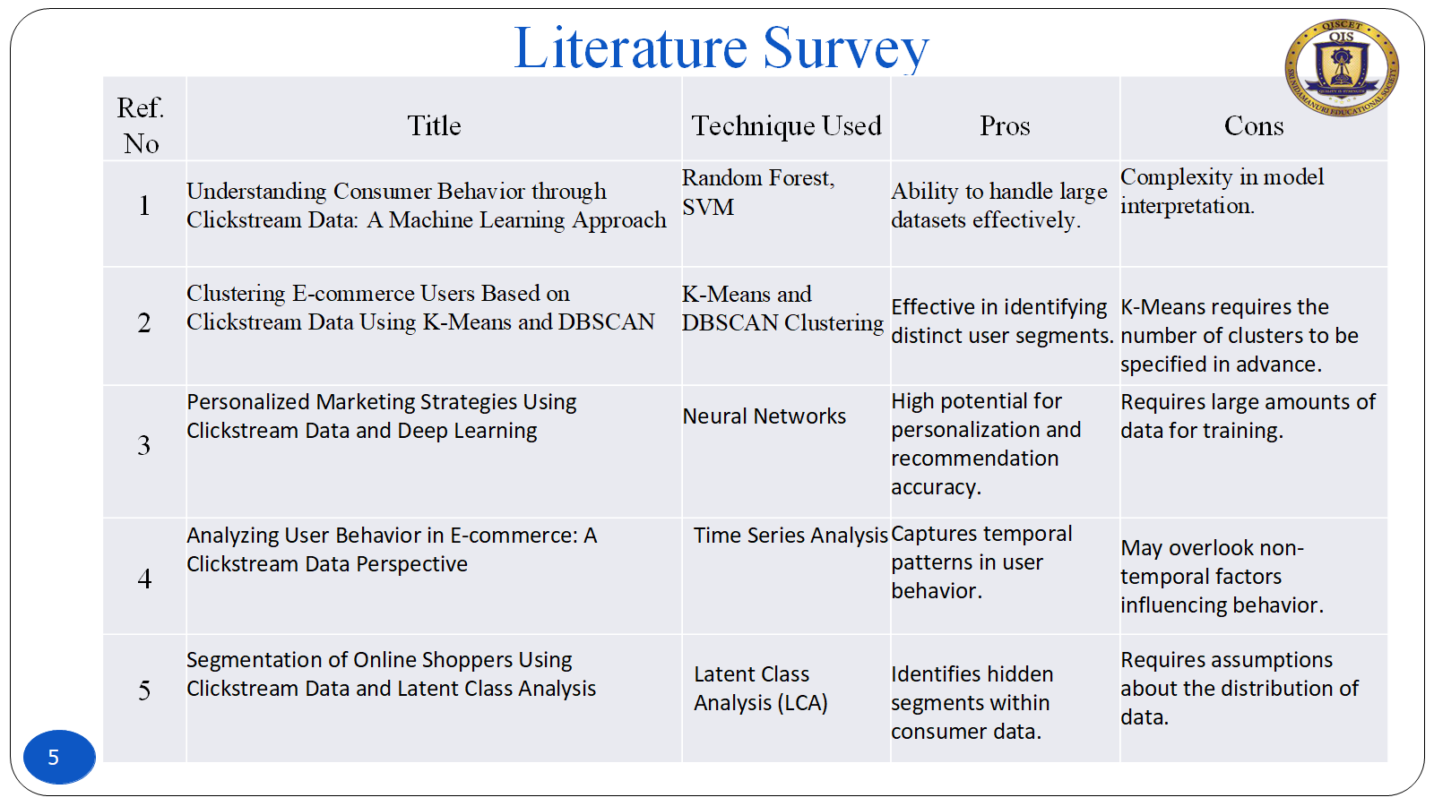
Literature Survey
Ref. No | Title | Technique Used | Pros | Cons
1 | Understanding Consumer Behavior through Clickstream Data: A Machine Learning Approach | Random Forest, SVM | Ability to handle large datasets effectively. | Complexity in model interpretation.
2 | Clustering E-commerce Users Based on Clickstream Data Using K-Means and DBSCAN | K-Means and DBSCAN Clustering | Effective in identifying distinct user segments. | K-Means requires the number of clusters to be specified in advance.
3 | Personalized Marketing Strategies Using Clickstream Data and Deep Learning | Neural Networks | High potential for personalization and recommendation accuracy. | Requires large amounts of data for training.
4 | Analyzing User Behavior in E-commerce: A Clickstream Data Perspective | Time Series Analysis | Captures temporal patterns in user behavior. | May overlook non-temporal factors influencing behavior.
5 | Segmentation of Online Shoppers Using Clickstream Data and Latent Class Analysis | Latent Class Analysis (LCA) | Identifies hidden segments within consumer data. | Requires assumptions about the distribution of data.

Slide 6
Literature Survey
Ref. No | Title | Technique Used | Pros | Cons
6 | Enhancing E-commerce Recommendations with Clickstream Data and Reinforcement Learning | Reinforcement Learning. | Adapts to changing consumer preferences over time. | Requires a well-defined reward structure.
7 | Using Clickstream Data for Predictive Analytics in E-commerce | Predictive Analytics (Regression Models) | Provides actionable insights for marketing strategies. | May not capture non-linear relationships well.
8 | Consumer Behavior Analysis in E-commerce Using Clickstream Data and Social Media Integration | Data Integration and Analysis | Combines multiple data sources for richer insights. | Data integration can be complex and time-consuming.
9 | Clickstream Data Analysis for Improving User Experience in E-commerce | User Experience (UX) Analytics. | Directly addresses user experience improvements. | Focused primarily on UX may overlook sales metrics.
10 | A Hybrid Approach to Consumer Segmentation Using Clickstream Data and Machine Learning | Hybrid Machine Learning | Combines strengths of multiple algorithms for better accuracy. | Increased complexity in model training and interpretation.

Slide 7
Motivation
Monitoring and analyzing clickstream data from different clients offers valuable insights and serves multiple motivations for businesses, marketers, and developers. The main reasons are:
Understanding User Behavior: Clickstream data tracks the sequence of actions users take— such as pages visited, links clicked, and time spent on each step. This helps reveal how clients interact with a website, app, or platform, identifying patterns, preferences, and pain points. 2
Improving User Experience: By analyzing where users drop off, linger, or encounter friction, businesses can optimize navigation, streamline interfaces, and enhance functionality to make the experience more intuitive and engaging.
Personalization: Tracking individual click patterns allows companies to tailor content, recommendations, or promotions to specific clients. For example, e-commerce sites can suggest products based on browsing history, increasing relevance and satisfaction.
Boosting Conversion Rates: Clickstream analysis highlights what drives users toward desired actions (e.g., purchases, sign-ups) and what deters them. This enables targeted improvements to funnels, calls-to-action, or checkout processes to maximize conversions
Marketing Optimization: Understanding which links, ads, or campaigns drive traffic and engagement helps refine marketing strategies. It also reveals which channels or messages resonate most with different client segments.
Performance Monitoring: Clickstream data can expose technical issues—like slow-loading pages or broken links—allowing teams to address problems that might otherwise frustrate users and harm retention.
Business Intelligence and Decision-Making: Aggregated data provides a big-picture view of trends, such as peak usage times or popular features. This informs resource allocation, product development, and strategic planning.
Competitive Advantage: Companies that leverage clickstream insights can stay ahead by quickly adapting to client needs and preferences, outpacing competitors who rely on less granular feedback.

Slide 8
Objective
The objective of this project is to analyze clickstream data to gain a deeper understanding of user behavior and segment users based on their browsing patterns and interactions. Clickstream data, which captures user activities such as page views, clicks, and conversions, provides valuable insights into how users navigate a website. By leveraging machine learning techniques like K-Means and DBSCAN clustering, the project identifies distinct user groups, including high-engagement users, casual browsers, cart abandoners, and potential buyers. These clusters help in understanding how different types of users interact with the website and what factors influence their decision-making.
To achieve this, key metrics such as session duration, total page views, bounce rate, click patterns, and conversion rates are extracted and analyzed. These features allow the model to group users based on similarities in their browsing behavior. K-Means clustering helps in segmenting users into predefined groups based on numerical patterns, while DBSCAN is useful for identifying anomalies such as bots or irregular browsing behavior. The insights gained from this segmentation process enable businesses to optimize their marketing strategies, personalize user experiences, improve customer retention, and enhance website performance. For example, identifying frequent visitors who do not complete purchases can help businesses implement targeted promotions or retargeting strategies. Similarly, recognizing high-value customers allows for better loyalty programs and personalized recommendations.
Ultimately, this project provides a data-driven approach to improving website efficiency and engagement by helping businesses understand their audience, refine user experience strategies, and drive higher conversions. By applying machine learning techniques to real-time user interactions, organizations can make informed decisions that enhance customer satisfaction and boost overall business performance.

Slide 9
Existing Method
This is because clickstream data are a form of big data, and thus, it is characterized by large volumes, which are difficult to process. As shown in the ASOS example, however, if the appropriate data analytics methods are employed, clickstream data can derive valuable insights to support marketing activities As demonstrated by ASOS, one potentially useful application of clickstream data in marketing research and practice is consumer segmentation. Consumer segmentation is defined as the division of consumers into groups of buyers who share distinct characteristics and behaviors that might require separate products or marketing mixes. Recognizing consumer heterogeneity, much has been written about consumer segmentation in the offline environment, there is, however, a handful of research on consumer segmentation according to consumers’ online behavior. Existing studies on consumer online segmentation are limited in terms of insights.
Disadvantages:-
Data Overload and Noise
Privacy and Compliance Challenge
Limited Real-Time Analysis
Incomplete Contextual Understanding
Scalability Issues
Integration Gaps
Accuracy and Attribution Problems

Slide 10
Proposed Method
The proposed system for revealing consumer segments using clickstream data involves a multistep process that leverages advanced data analytics and machine learning techniques to understand and categorize consumer behavior on e-commerce platforms. The system begins with the collection of clickstream data, which includes detailed logs of user interactions, such as page views, clicks, product searches, and purchase actions. This raw data is then preprocessed to remove noise and standardize the format, ensuring consistency and accuracy.Following preprocessing, the data undergoes feature extraction where meaningful attributes are identified.
These features might include session duration, frequency of visits, types of products viewed, and patterns of navigation through the website. Next, clustering algorithms such as K-means, DBSCAN, or hierarchical clustering are applied to group users into distinct segments based on their behavioral patterns. These segments can range from 'browsers' who frequently visit but rarely purchase, to 'bargain hunters' who extensively compare prices before making a purchase, to 'loyal customers' who regularly buy specific brands or types of products.To enhance the segmentation process, machine learning models are employed to analyze and predict user behavior. For instance, using supervised learning techniques, the system can classify new users into predefined segments based on their initial interactions with the platform.
Additionally, advanced models such as neural networks can uncover complex patterns and insights that traditional methods might miss.The resulting consumer segments are then validated and refined using metrics such as silhouette scores and Davies-Bouldin index to ensure they are meaningful and actionable.

Slide 11
Proposed Method
The final results include visualizations of user clusters, insights into behavioral trends, and recommendations for personalized marketing strategies. These insights empower businesses to optimize their website structure, improve targeted advertising, and enhance customer engagement, ultimately leading to higher conversion rates and improved user experience.
Advantages :
Automated User Segmentation
Better Customer Insights
Improved Marketing Strategies
Real-Time Analysis
Fraud Detection & Bot Filtering
Optimized Website Experience
Scalability & Adaptability

Slide 12
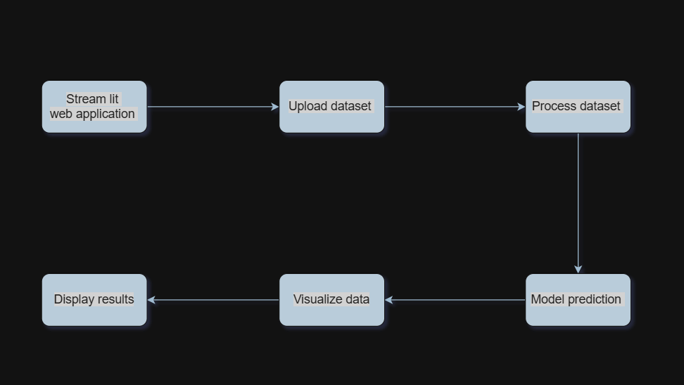
Block diagram

Slide 13
Explanation of Proposed Work
Data Collection
Objective: Gather raw clickstream data from e-commerce websites.
Process:
Collect data on user interactions, such as clicks, page views, session durations, and purchase history.
Ensure the dataset includes both numerical (e.g., time spent) and categorical (e.g., product categories) variables.
Outcome: A comprehensive dataset ready for preprocessing and analysis.
2. Data Preprocessing
Objective: Clean and prepare the data for analysis.
Process:
Handle missing values by imputation or removal.
Remove duplicate entries and outliers.
Normalize numerical data and encode categorical data for consistency.
Outcome: A clean, normalized dataset suitable for advanced analysis.

Slide 14
Explanation of Proposed Work
Streamlit Web Application
Function: Serves as the user interface for interacting with the application.
Description: Users access the application through a web browser to initiate the workflow.
Upload Dataset
Function: Allows users to upload datasets for processing.
Description: Users select and upload various datasets (e.g., CSV, Excel) from their local system.
Process Dataset
Function: Prepares the dataset for analysis.
Description: Involves cleaning, transforming, and structuring the data for model training and predictions.
Model Prediction
Function: Utilizes a trained model to generate predictions based on the processed dataset.
Description: This step applies machine learning algorithms to the data to derive insights or classifications.

Slide 15
Explanation of Proposed Work
Visualize Data
Function: Represents the processed data graphically.
Description: Provides visualizations (e.g., charts, graphs) to help users understand patterns in the data.
Display Results
Function: Presents the outcomes of predictions and visualizations to the user.
Description: Outputs predicted values and visual aids directly on the web application interface.

Slide 16
Software Involved
Operating System : Windows 7/8/10
Server Side Script : CSS, HTML
Programming Language : Python
Libraries : Numpy, Pandas, plotly, scikit-learn, Streamlit
IDE/Workbench : PyCharm

Slide 17
Hardware Involved
Processor - I3/Intel Processor
RAM - 8GB (min)
Hard Disk - 128 GB
Key Board - Standard Windows Keyboard

Slide 18
Application & Advantages
Applications:
E-Commerce Platforms:
Personalized, low-cost product recommendations.
Real-time product comparisons and price tracking.
Customer Support:
Answers product-related queries and guides purchasing decisions.
Market Analysis:
Analyzes consumer preferences and predicts market trends.
Savings & Deal Hunting:
Identifies the best deals and discounts across multiple platforms.
Cross-Platform Shopping:
Provides comparisons of products across different e-commerce sites.

Slide 19
Application & Advantages
Advantages:
Improved Scalability: The system is designed to handle large volumes of data efficiently, ensuring faster processing and more accurate results.
Granular Segmentation: Advanced algorithms enable more precise segmentation of consumers based on detailed behavior patterns.
Enhanced Personalization: The system provides personalized recommendations and marketing strategies tailored to individual user preferences.
Real-Time Insights: Real-time data processing allows for immediate insights and adjustments to marketing strategies.

Slide 20
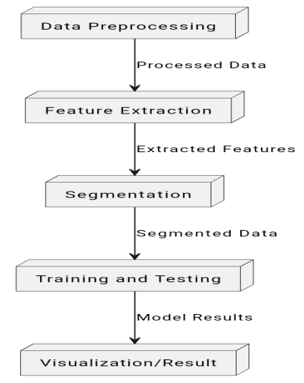
System Architecture/Proposed work Block diagram

Slide 21
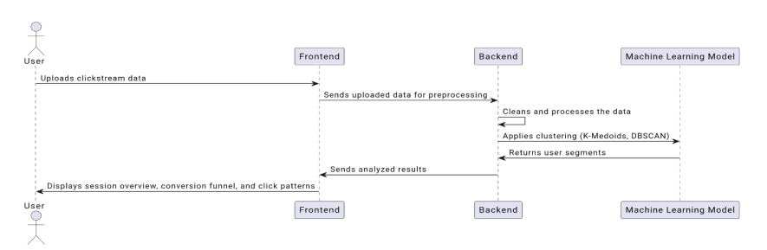
System Architecture/Proposed work Block diagram
SEQUENCE DIAGRAM:

Slide 22
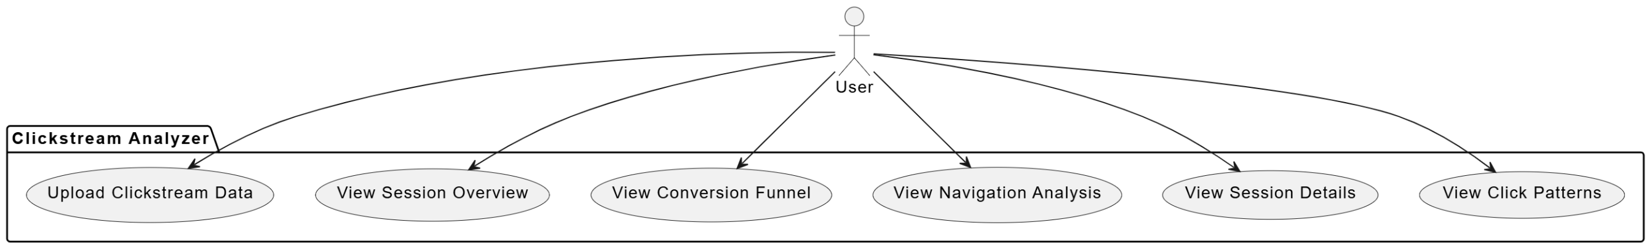
UML Diagram

Slide 23
Implementation(Sample code)
Content:
The implementation of the proposed methodology involves several key steps, including data preprocessing, feature extraction, and clustering.
Data Preprocessing:
The first step is to load the clickstream data from a CSV file using Pandas.
Missing values are handled by removing any rows with NaN entries to ensure data integrity.
Timestamps are converted to a datetime format for accurate time-based analysis.
Feature Extraction:
Key features such as session duration and total clicks are extracted for clustering.
These features are then standardized using ‘StandardScaler’ to ensure that they contribute equally to the clustering process.
Clustering:
K-Means clustering is applied to segment users into distinct groups based on their browsing behavior.
The optimal number of clusters is determined using the Elbow Method, which helps identify the point where adding more clusters yields diminishing returns.

Slide 24
Implementation(Sample code)
Sample code :-
import pandas as pd
from sklearn.cluster import KMeans
from sklearn.preprocessing import StandardScaler
# Load and preprocess data
data = pd.read_csv('clickstream_data.csv')
data.dropna(inplace=True) # Remove missing values
# Feature extraction
features = data[['session_duration', 'total_clicks']]
scaler = StandardScaler()
scaled_features = scaler.fit_transform(features)
# K-Means clustering
kmeans = KMeans(n_clusters=3)
data['cluster'] = kmeans.fit_predict(scaled_features)

Slide 25
Testing/Simulation
Types of Testing:
Unit Testing: Each component of the system is tested individually to verify that it performs as expected. This includes testing data loading, preprocessing functions, and clustering algorithms.
Integration Testing: After unit testing, the components are integrated, and the interactions between them are tested. This ensures that data flows correctly through the system and that the components work together seamlessly.
Acceptance Testing: This phase involves validating the system against user requirements. End-users test the system to ensure it meets their needs and expectations.
Simulation:
Simulations are conducted to evaluate the performance of the clustering algorithms on various datasets.
Metrics such as silhouette scores and Davies-Bouldin index are used to assess the quality of the clusters formed.
The results of the simulations indicate that the proposed method effectively segments users based on their behavior, providing actionable insights for marketing strategies.

Slide 26
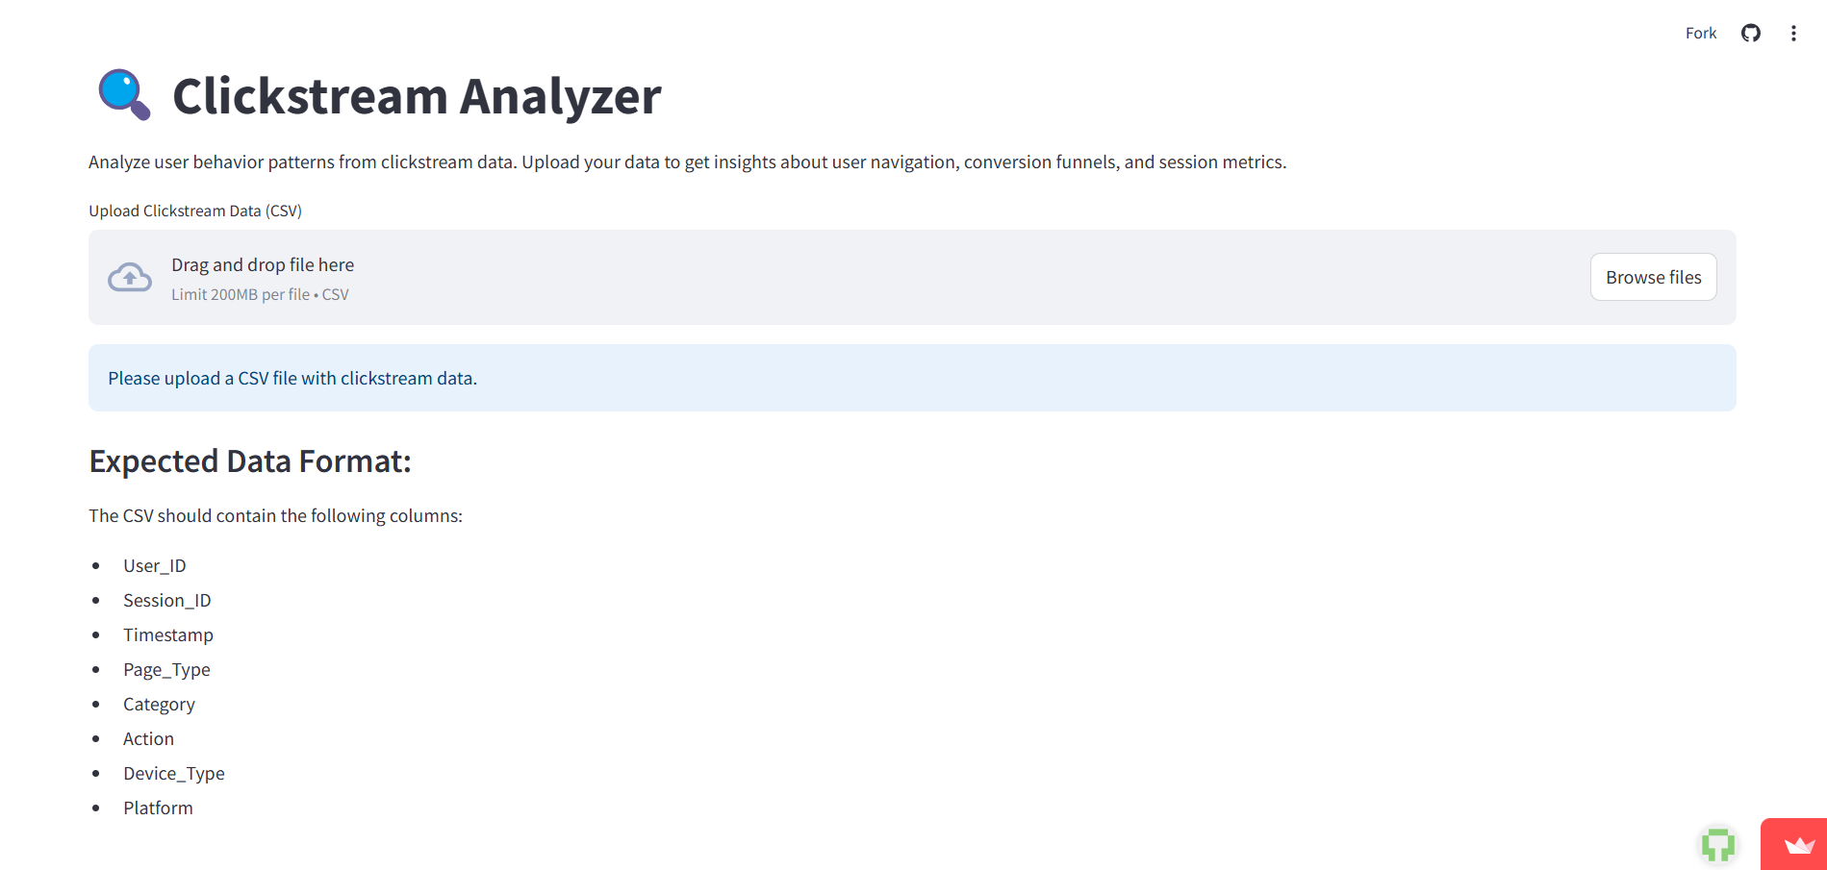
Testing/Simulation
Home page:-

Slide 27
Results & Discussion
Consumer Segmentation:
The K-Means clustering algorithm successfully identified distinct consumer segments, including high-engagement users, casual browsers, and cart abandoners.
Each segment exhibits unique browsing patterns and purchasing behaviors, allowing for tailored marketing strategies.
Visualization of Results:
Visualizations, such as scatter plots and bar charts, illustrate the distribution of users across different segments.
The conversion funnel analysis reveals significant drop-off points, particularly between adding items to the cart and completing purchases, indicating areas for improvement in the checkout process.
Implications for Marketing:
The insights gained from the segmentation can inform targeted marketing campaigns, personalized recommendations, and improved user experiences.
Businesses can leverage this data to enhance customer retention and increase conversion rates by addressing the specific needs and behaviors of each segment.
Overall, the results demonstrate the effectiveness of using clickstream data for consumer analysis and the potential for driving business growth through data-driven decision-making.

Slide 28
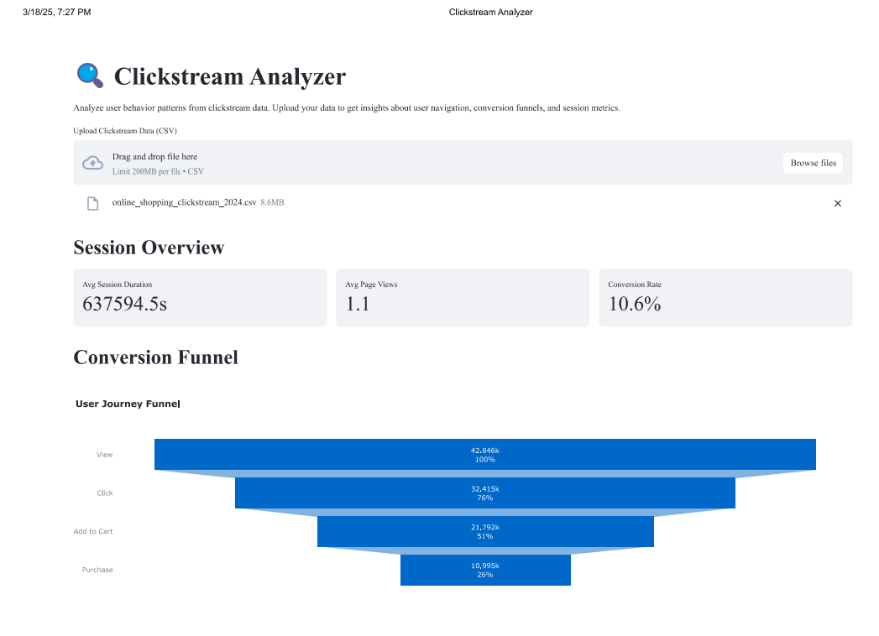
Results & Discussion
Output:-

Slide 29
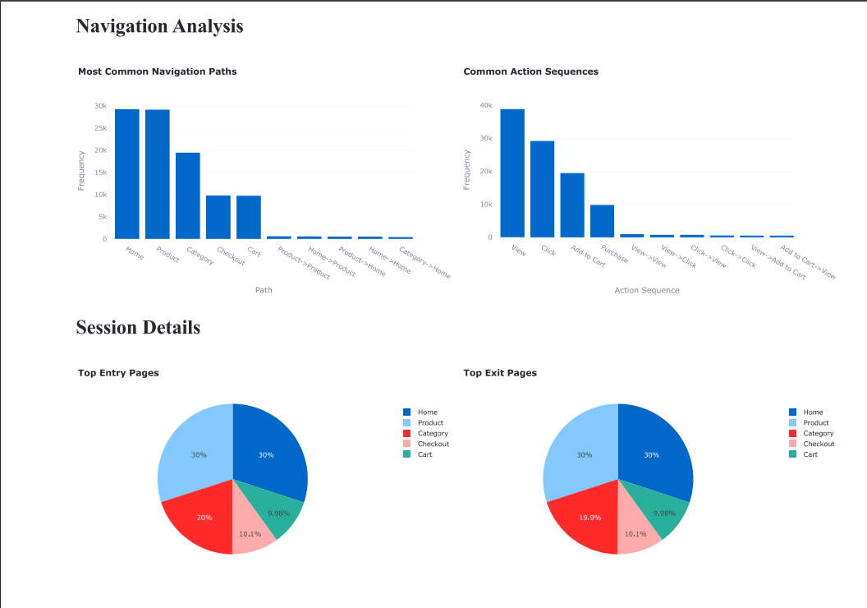
Results & Discussion
Output:-

Slide 30
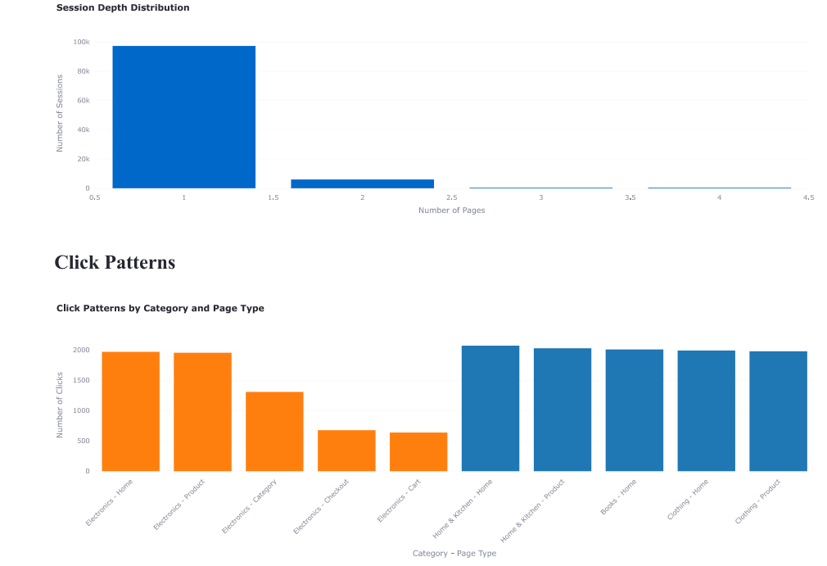
Results & Discussion
Output:-

Slide 31
Conclusion & Future Scope
In conclusion, this project successfully developed a system for analyzing clickstream data to unveil consumer segments, providing valuable insights into user behavior.
The application of machine learning techniques, specifically K-Means and DBSCAN clustering, has proven effective in identifying distinct user groups based on their browsing patterns.
Key Contributions:
Enhanced understanding of consumer behavior in the digital marketplace.
Development of a framework that businesses can use to optimize marketing strategies and improve user experiences.
Future Scope:
Future enhancements could include the integration of AI-driven recommendation systems that provide personalized product suggestions based on user behavior.
Implementing real-time data processing capabilities will allow businesses to respond dynamically to user actions and trends.
Further research could focus on enhancing predictive analytics to forecast user behavior trends, optimizing

Slide 32
References
Gumber, M., Jain, A., & Amutha, A. L. (2021, May). Predicting Customer Behavior by Analyzing Clickstream Data. In 2021 5th International Conference on Computer, Communication and Signal Processing (ICCCSP) (pp. 1-6). IEEE.
Somya, R., Winarko, E., & Privanta, S. (2021, September). A novel approach to collect and analyze market customer behavior data on online shop. In 2021 2nd International Conference on Innovative and Creative Information Technology (ICITech) (pp. 151-156). IEEE.
Pal, G., Atkinson, K., & Li, G. (2023). Real-time user clickstream behavior analysis based on apache storm streaming. Electronic Commerce Research, 23(3), 1829-1859.
Noviantoro, T., & Huang, J. P. (2021). Applying data mining techniques to investigate online shopper purchase intention based on clickstream data. Rev Bus Account Financ, 1(2), 130-159.
Zavali, M., Lacka, E., & De Smedt, J. (2021). Shopping hard or hardly shopping: Revealing consumer segments using clickstream data. IEEE Transactions on Engineering Management, 70(4), 1353-1364.

Slide 33
THANK YOU

